Slide 1
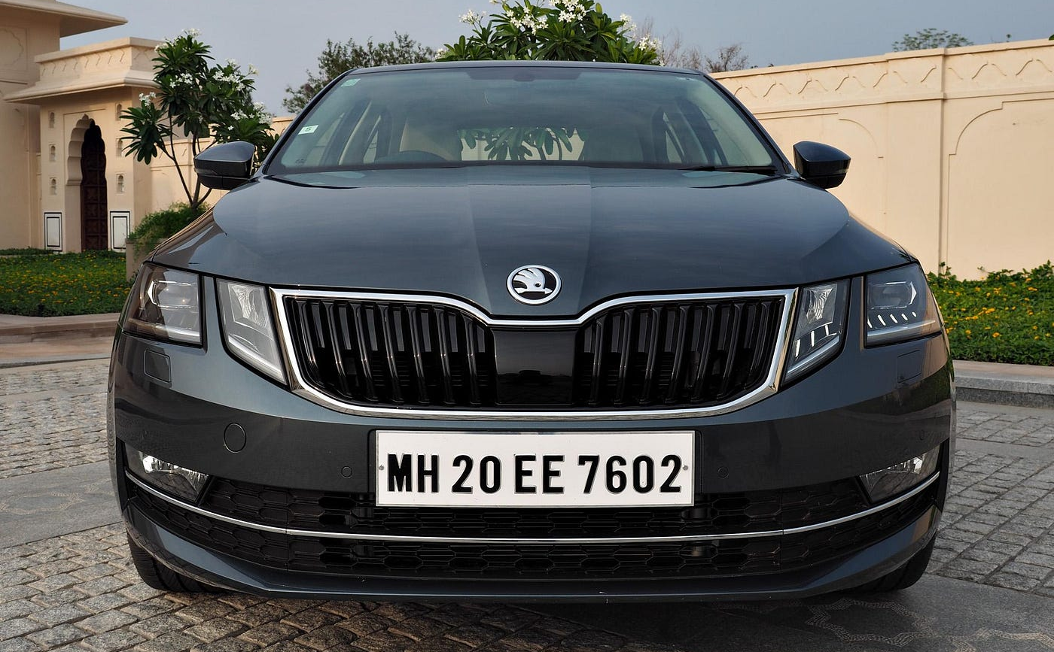
Licence Plate Detection
Image Processing Term Project
Ali Oğulcan Et
Furkan Dönmez
Duygu Halisyama

Slide 2
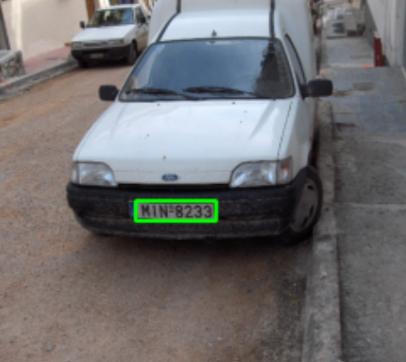
Goal:
The main objective of our project is to utilize image processing techniques to implement a license plate detection program capable of accurately identifying the locations of license plate(s) within a given image.

Slide 3
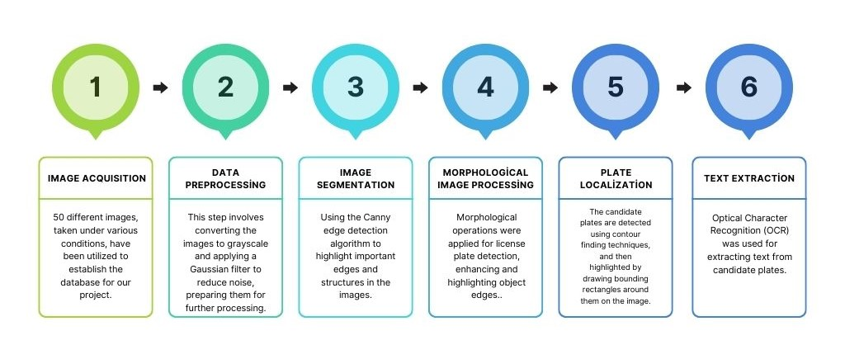
TECHNIQUES USED IN LICENSE PLATE RECOGNITION

Slide 4
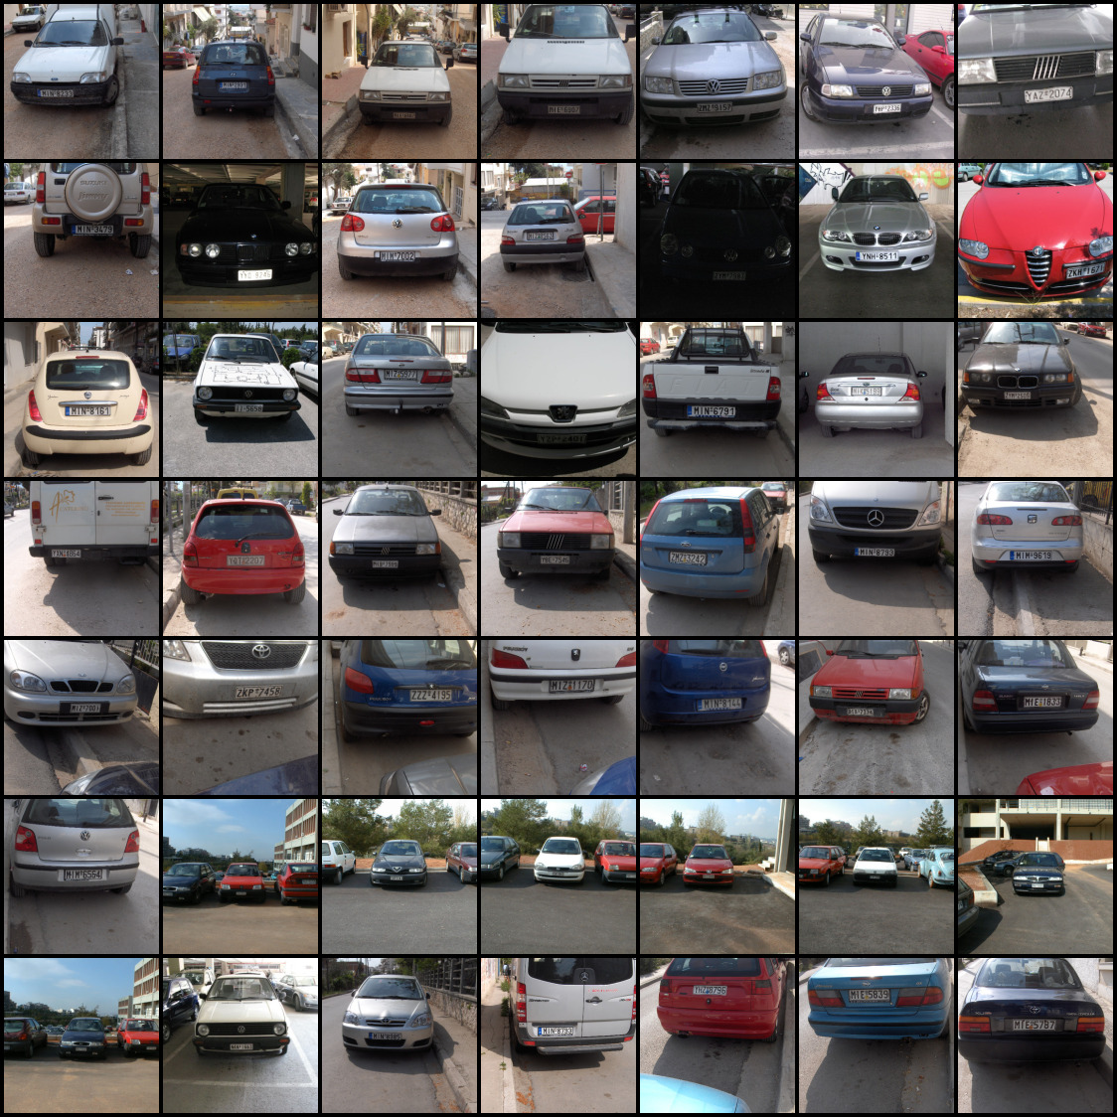
Image Acquisition
50 different images, taken under various conditions, have been utilized to establish the database for our project.

Slide 5
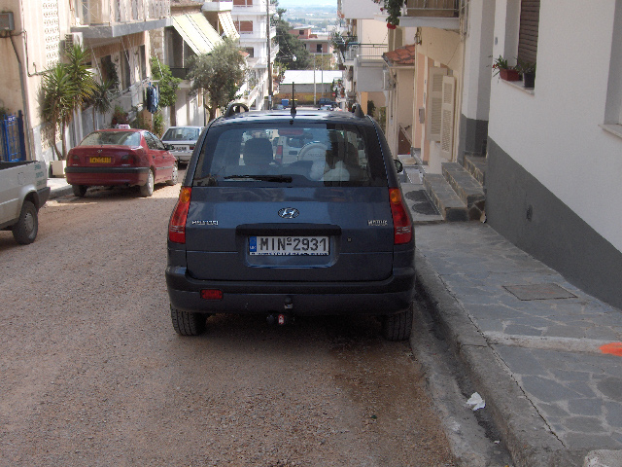
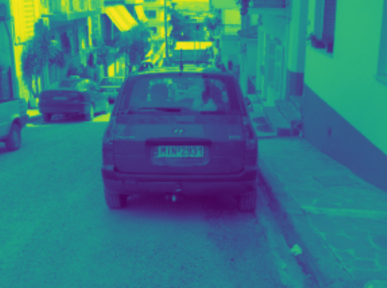

Data Preprocessing
The first step of this stage is to convert our images to grayscale format.

Slide 6
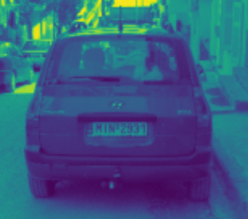
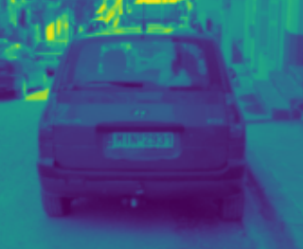
Data Preprocessing
After converting our image to gray scale format, we use Gaussian Blur to reduce noise and soften details in our image.

Slide 7
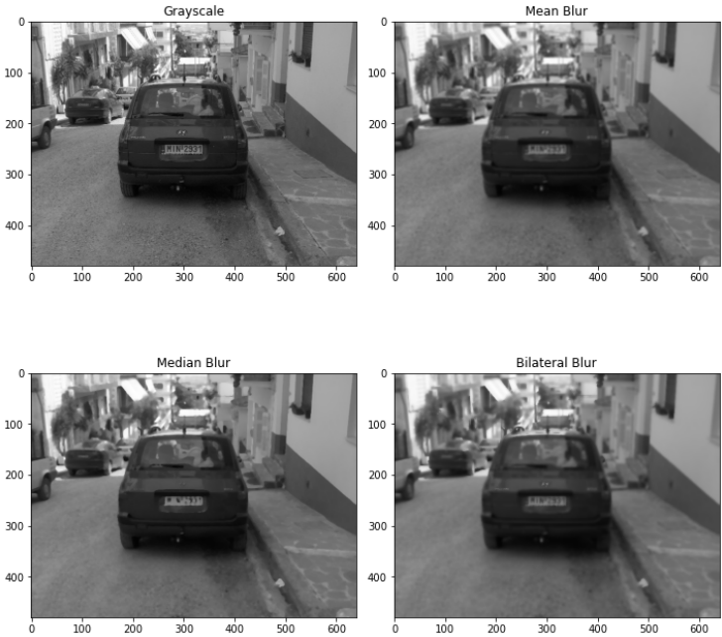

Slide 8
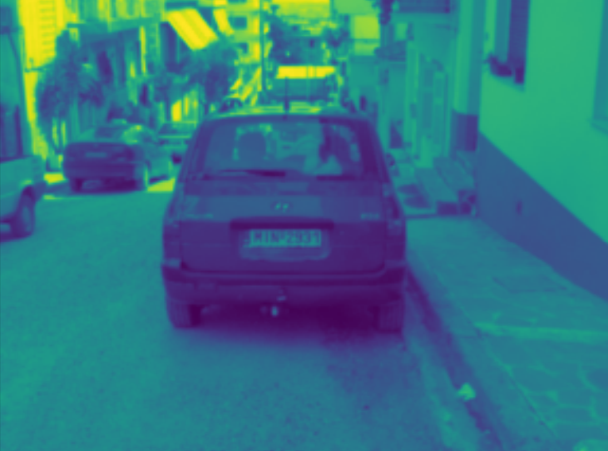
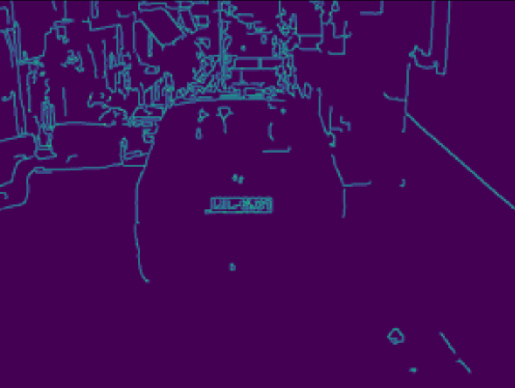
Image Segmentation
Using the Canny edge detection algorithm to highlight important edges and structures in the images.

Slide 9
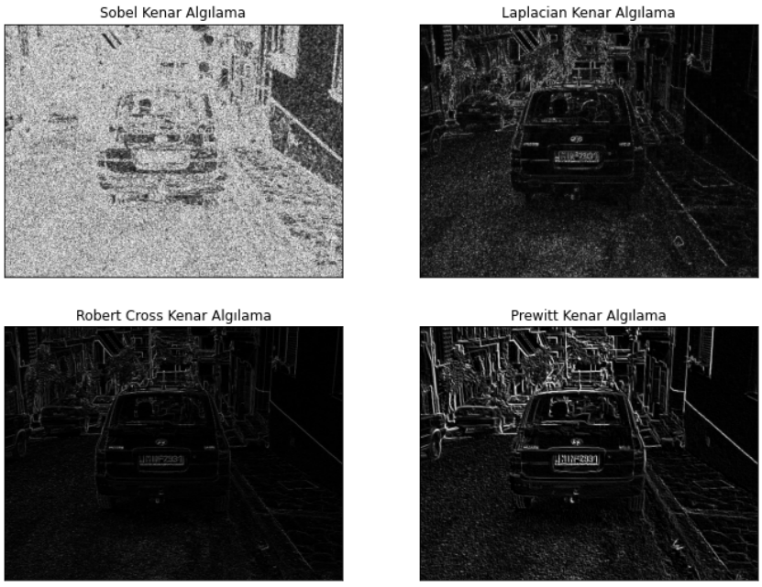

Slide 10
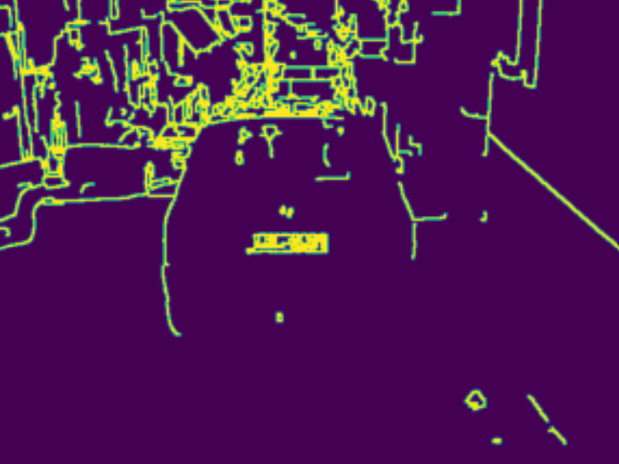
Morphological Image Processing
Morphological operations were applied for license plate detection, enhancing and highlighting object edges.

Slide 11
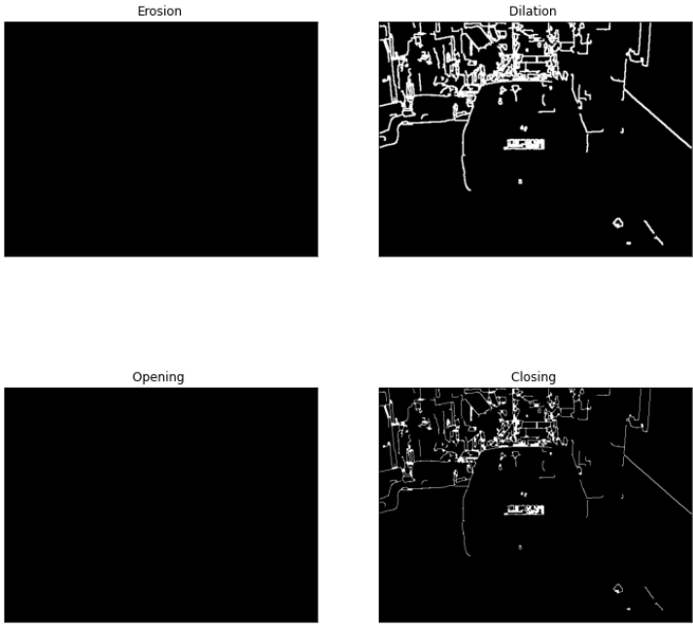

Slide 12
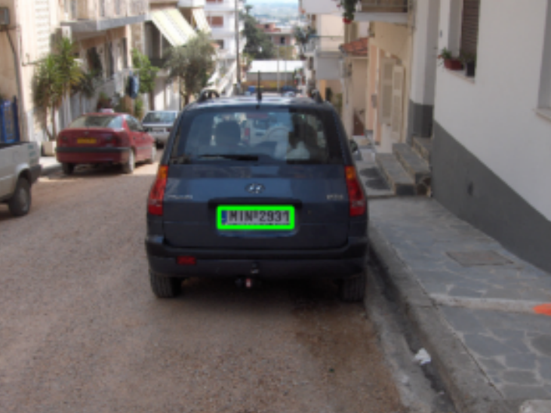
Plate Localization
The candidate plates are detected using contour finding techniques, and then highlighted by drawing bounding rectangles around them on the image.

Slide 13
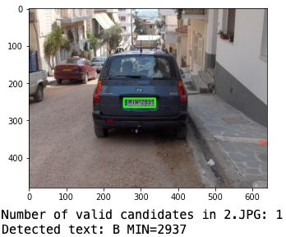
Text Extraction
Optical Character Recognition (OCR) was used for extracting text from candidate plates.

Slide 14
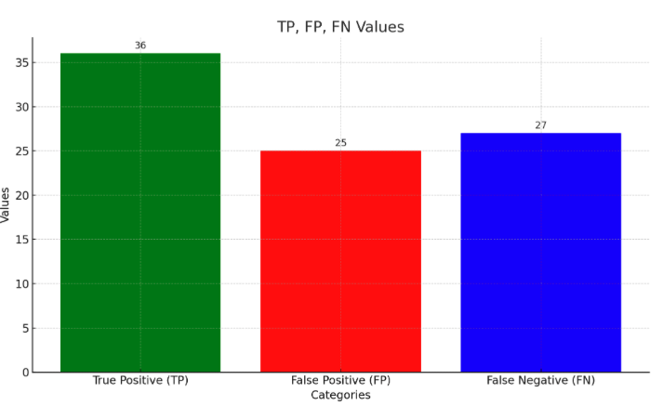
Performance Metrics
True Positive (TP): 36
False Positive (FP): 25
False Negative (FN): 27

